Slide 1
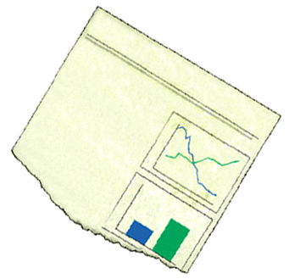
Knowledge Connections
Annual Report
Reduced cost
Increased efficiency
Improved products & services
Better, faster decisions
Energized innovation
Business transformation
People to People
People to Communities of Practice
People to Workflows
People to Best Practices & Lessons Learned
People to Information
From: http://www.reidgsmith.com/Connections.htm
Notes:
Knowledge Management must be focused on achieving business results. They could be drawn from an annual report or a performance scorecard. To realize business benefits from your knowledge management program, five robust knowledge connections are required.
People to People. Ensure that people who need knowledge can find people who have it and can contact them easily.
People to Information. Maximize the return from existing information assets.
People to Communities of Practice. The Community of Practice (CoP) is a fundamental knowledge management building block.
People to Best Practices and Lessons Learned. Put in place standard processes for knowledge seeking, sharing and validation and make them a part of the "work environment.“
People to Workflows. Embed the knowledge connections in your business processes.
If you build robust knowledge connections, you remove the clutter from people's jobs. You maximize their ability to contribute productively and create value. You give them the confidence of knowing that they are riding on top of the best knowledge and experience held by the overall organization.
For details, see: http://www.reidgsmith.com/Connections.htm

